Slide 1
Health Protection Surveillance Centre
Surveillance of Infectious Intestinal Disease (IID) in Ireland:
Q1 2019 provisional data
July, 2019

Slide 2
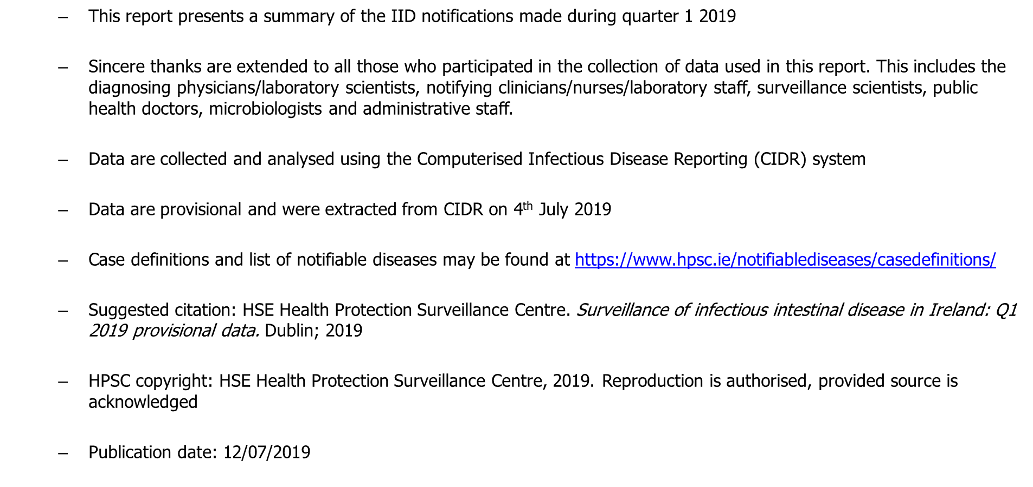
Provisional data, Q1 2019

Slide 3
Key Points

Slide 4
IID disease notifications in Q1 2019

Slide 5
Campylobacter infection in Ireland, Q1 2019

Slide 6
Salmonellosis in Ireland, Q1 2019

Slide 7
Salmonellosis in Ireland, Q1 2019

Slide 8
Verotoxigenic E. coli (VTEC) in Ireland, Q1 2019

Slide 9
Verotoxigenic E. coli (VTEC) in Ireland, Q1 2019

Slide 10
Shigellosis in Ireland, Q1 2019

Slide 11
Listeriosis in Ireland, Q1 2019

Slide 12
Cryptosporidiosis in Ireland, Q1 2019

Slide 13
Giardiasis in Ireland, Q1 2019

Slide 14
Noroviral infection in Ireland, Q1 2019

Slide 15
Rotaviral infection in Ireland, Q1 2019

Slide 16
Further Information
Further information on IID pathogens can be found at
https://www.hpsc.ie/a-z/gastroenteric/

